Slide 1
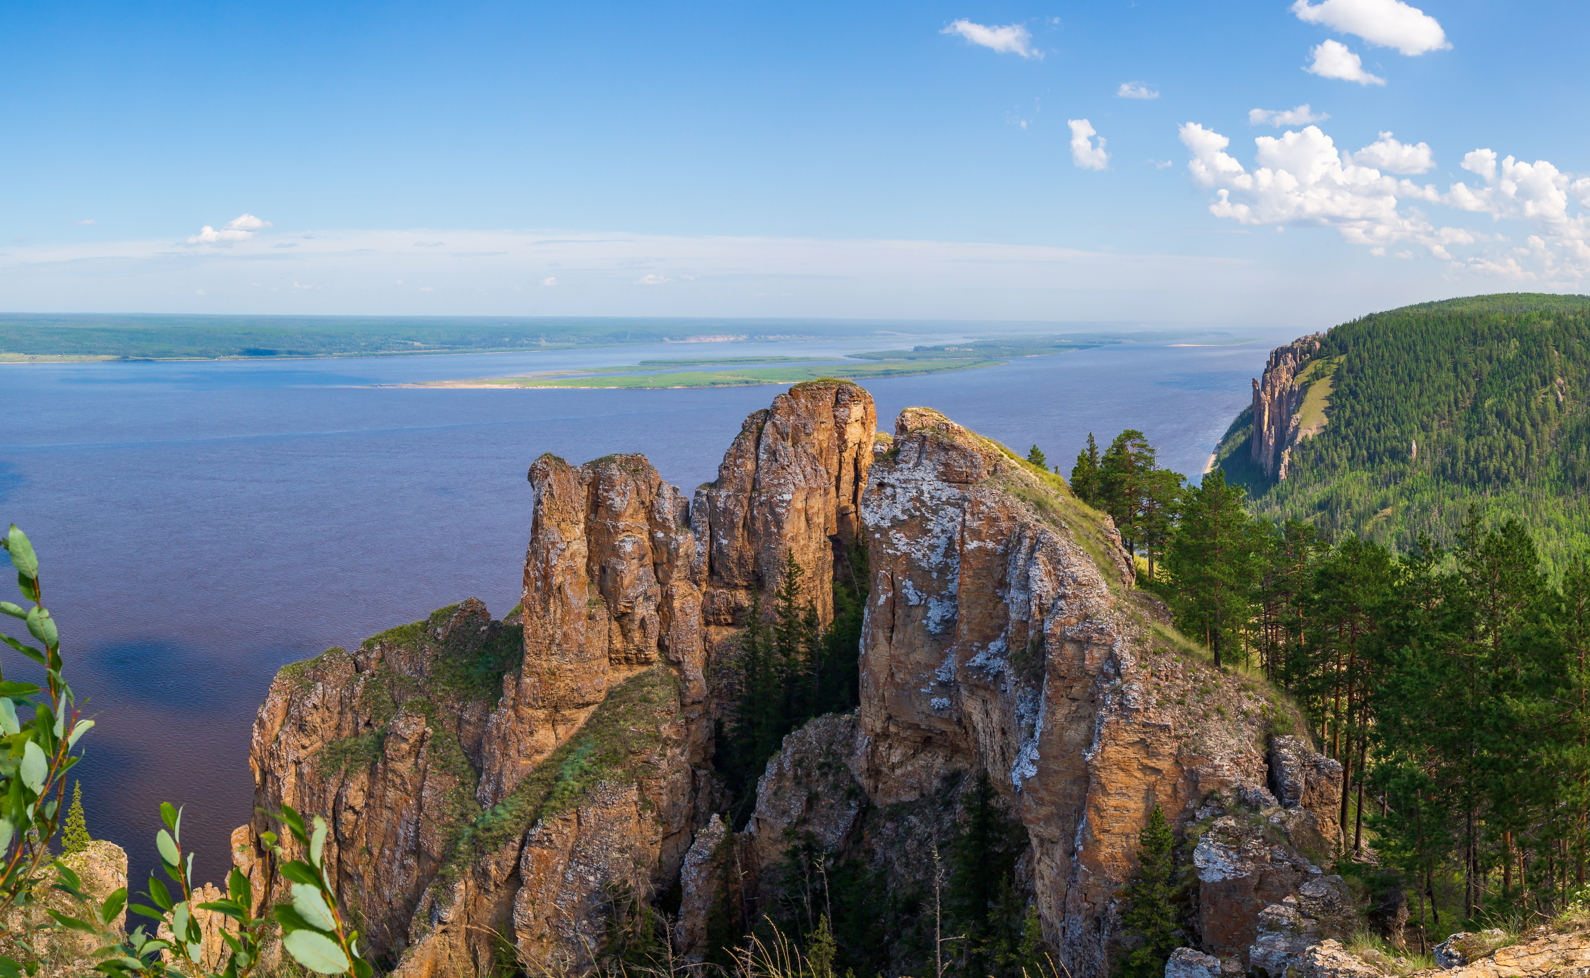

Analysis of mass variation in the Lena river basin using GRACE.
AESM5210C - David Haasnoot
Photo: Andrei Berezovskii, istockphoto.com
Notes:
Hello everybody, I’ll be presenting my project on the mass variations in the Lena Basin

Slide 2
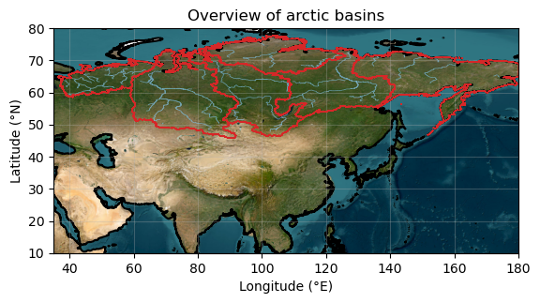
Why mass are mass variations important?
Fresh water discharge arctic ocean
Global ocean circulation
Sea level rise
Region affected by Climate change
Notes:
I’d like to start with why we are interested in mass variations in the lena basin in the first place.
On the map you the rivers which drain into the arctic ocean from Eurasia.
The

Slide 3
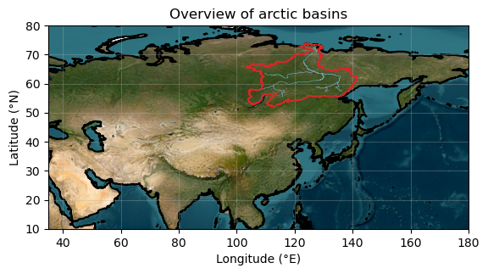
Lena Basin
2 400 000 km
Large enough for grace
Well studied
Landerer, 2010
Vey, 2012
Velicogna, 2012
Mixed results & data till 2012
Notes:
From these basin I studie the Lena basin because …

Slide 4

Data
Stokes coefficients GRACE:
ITSG-Grace2018 – TU Graz
Smoothed DDK4 – UTCSR
Replace: $C_{1,0}$, $C_{1,1} \& C_{2,1}$ (leander, 2023)
$C_{2,0} \& C_{3,0} (\text{Loomis}\text{, }\text{2020})$
Glacial Interstatic Adjustment
Thegraceplotter.com - GFO
Notes:
The data used …

Slide 5

Processing stokes coefficients
Scaling:
${\overline{C}}_{l,m}^{δh_{w}}=\frac{R\left(2l+1\right)}{3\left(1+k_{l}^{′}\right)}\frac{ρ_{av}}{ρ_{w}}{δ\overline{C}}_{l,m}$.
Computing 1°x1° per grid cell:
$$δh_{w}\left(θ,λ\right)=\sum_{l,m=0}^{∞}{{\overline{C}}_{l,m}^{δh_{w}}}{\overline{Y}}_{lm}\left(θ,λ\right).$$
For $θϵ\left[90,150\right] lon,$
$λϵ[50,80]$ lat
Notes:
We can scale the coefficients to equivalent water heights using the top equation
And calculate for a 1x1° gridcell

Slide 6
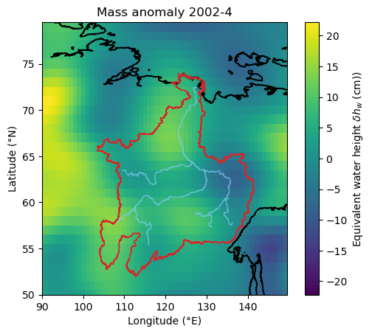
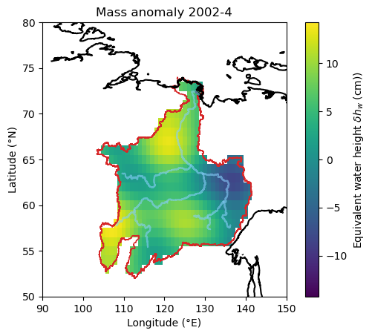
Maps of equivalent water height anomaly
Notes:
From this we obtain a map as following. Which can then be masked to just keep the area in the basin and we can then in turn obtain the mean of this value

Slide 7
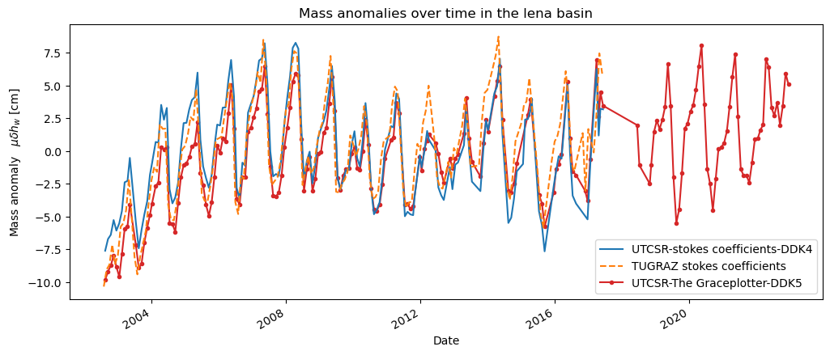
Timeseries
Notes:
This yields the time series as followed …

Slide 8
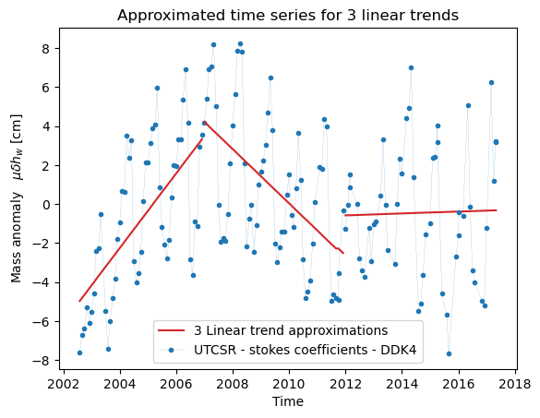
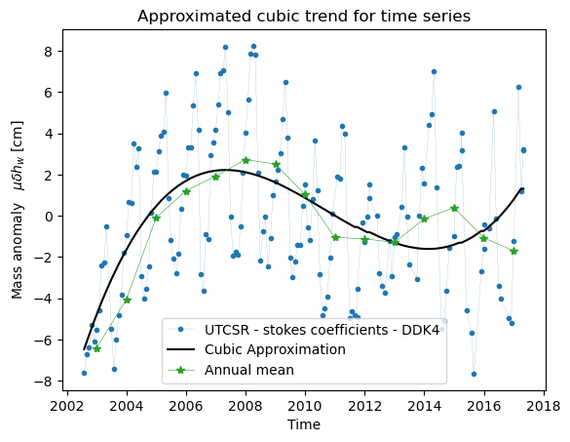
Trend – linear & cubic
RMSE = 3,15cm
RMSE = 3,21cm
Notes:
This yields the time series as followed …

Slide 9
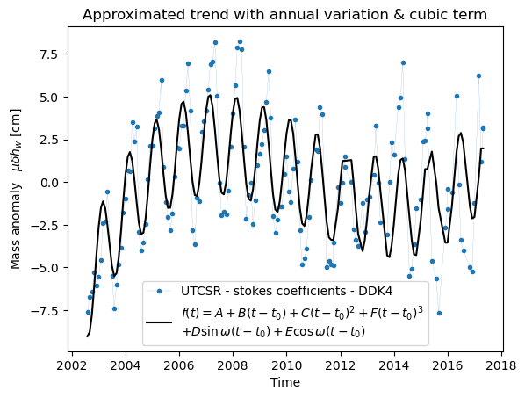
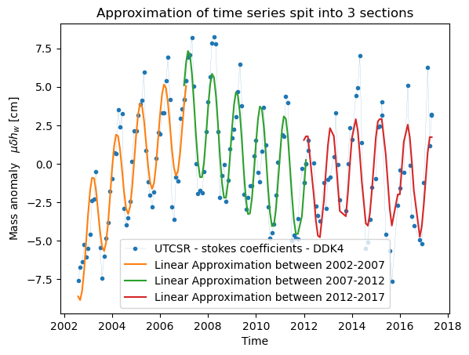

Trend – annual with cubic & split in 3
$$f\left(t\right)=A+B\left(t−t_{0}\right)+C{\left(t−t_{0}\right)}^{2}+D\sin{ω}\left(t−t_{0}\right)+E\cos{ω}\left(t−t_{0}\right)$$
RMSE = 2,41cm
RMSE = 1,84cm
Notes:
This yields the time series as followed …

Slide 10

Process coefficients
Compute amplitude & phase
$$F=\sqrt{D^{2}+E^{2}},ϕ=atan2\left(\frac{D}{E}\right)$$
$$σ_{F}=\sqrt{\frac{D^{2}σ_{D}^{2}+E^{2}σ_{E}^{2}+2DE cov\left[D,E\right]}{D^{2}+E^{2}}}, σ_{ϕ}=\frac{\sqrt{E^{2}σ_{D}^{2}+D^{2}σ_{E}^{2}−2DE cov\left[D,E\right]}}{D^{2}+E^{2}}$$
Other errors from covariance matrix
Notes:
This yields the time series as followed …

Slide 11
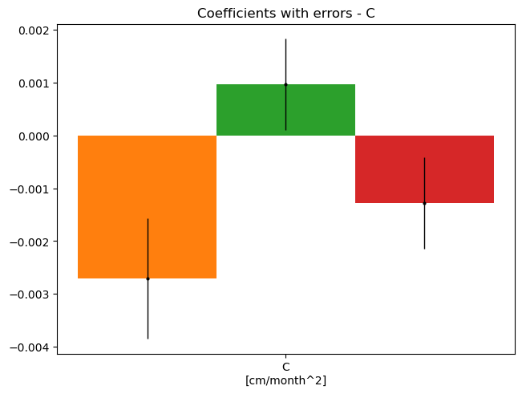
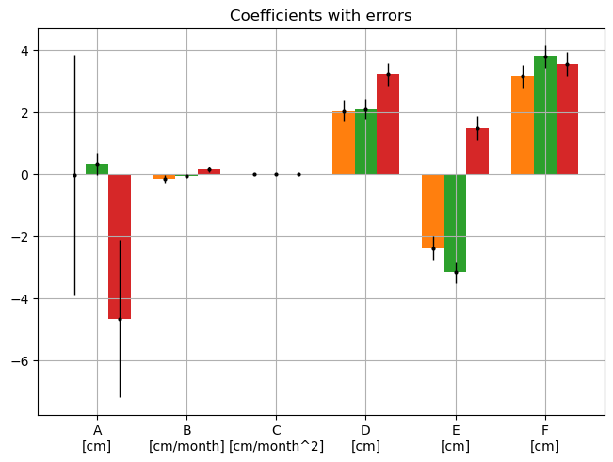
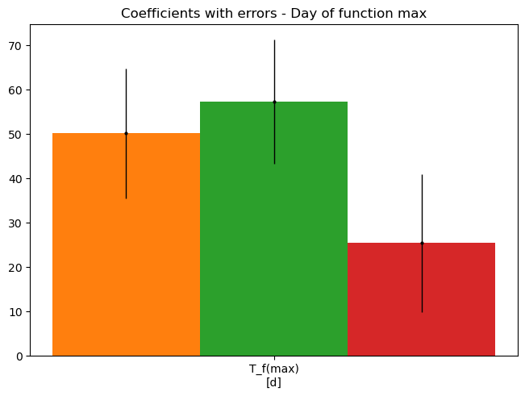
Coefficients significance
Notes:
This yields the time series as followed …

Slide 12
Change in trend
Notes:
This yields the time series as followed …

Slide 13
Questions?

